Slide 1

For any NBA basketball fan..
Who wants to know why their team is winning (or losing)

Slide 2

What is this about?
It is about the role of the 3-point shot in basketball when it comes to:
Winning games
Generating efficient shots
Winning the Larry O’Brien Trophy

Slide 3
What does it do?
https://george-r.github.io/final2/

Slide 4
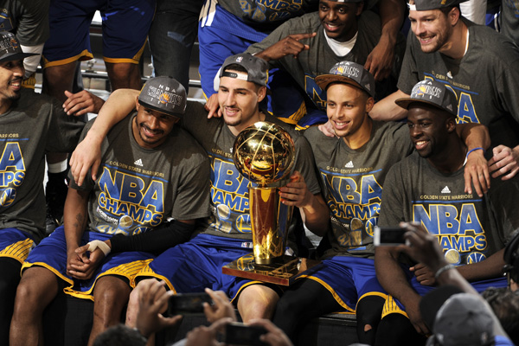
What will people learn?
This graphic should make it clear to the reader that:
Three-point shooting teams are more likely to have a winning season
The best NBA players focus on 3-point shots
Success from the 3-pt line results in a more efficient offense
More easy layups and therefore a higher chance to get to the free-throw line

Slide 5
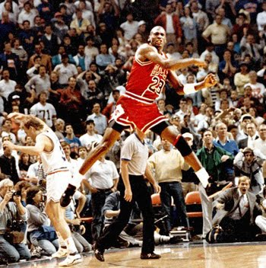
What went well
Managed to find all the data I need (this was not easy)
Loading so much data works fairly fast with a good internet connection
Able to link all the charts and graphics the way I envisioned
Enforce the belief I had that the 3-point shot is key to winning championships in the modern NBA

Slide 6
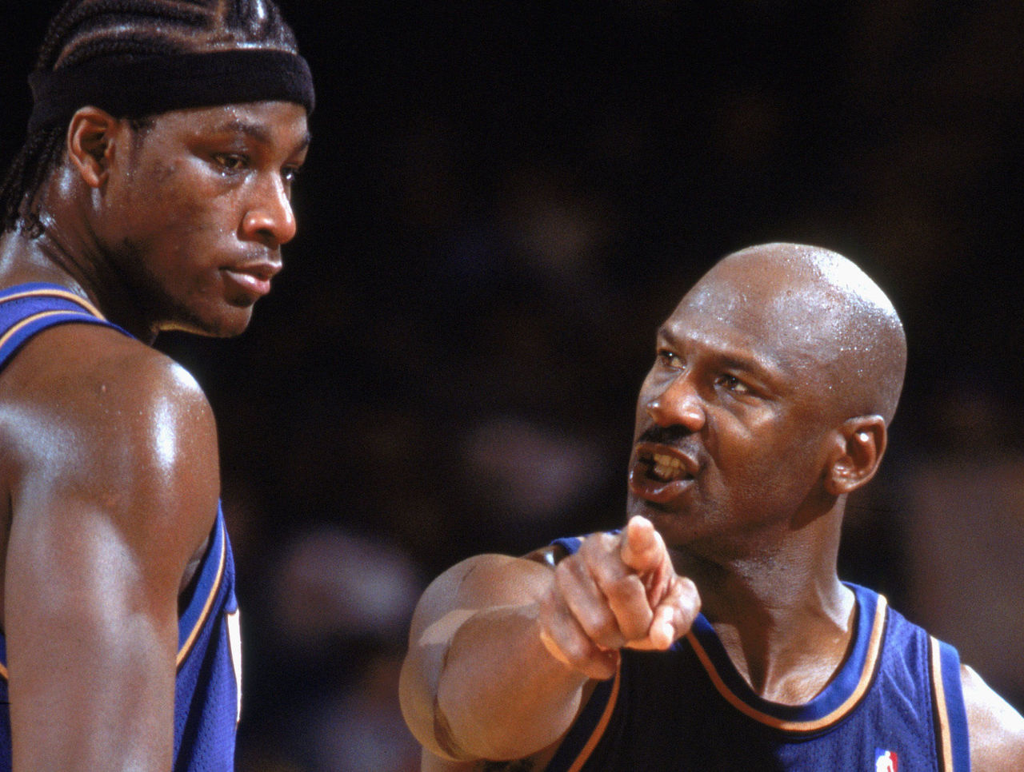
What to improve
Improve the layout (working on this)
Make it work on other platforms (phones and tablets)
Add playoff stats as well
IDEALLY update this with live data from the current season to give a relevant picture of what is happening today

